Slide 1
From Earth Jurisprudence to the Whole Legal System: Social Ecology and the Relational Approach to Law
Alex May

Slide 2
Introduction
Alex May – London, UK
Currently an independent with no organisational affiliation
More about me: www.alexmay.co.uk
More about my legal theory: www.interconnectedlaw.com
Twitter: @InterConLaw
Note: this presentation, including expanded article:
www.interconnectedlaw.com/Geneva2021

Slide 3
Main Point of the Presentation
We cannot transform only part of a (legal) system but must transform the whole system
Earth Jurisprudence is excellent but only partial
Therefore we need a broader approach for the entirety of our socio-ecological relations and activity

Slide 4
Earth Jurisprudence
Earth Jurisprudence is about the relationship between humans and the rest of Nature, how that relationship is destructive and requires changing our political, economic and legal systems, as well as a deeper spiritual and cultural transformation.
What about the rest of human activity?

Slide 5
Conceptualising Human-Nature Relationship
Alex May – Interconnected Law
10/12/21

Slide 6
Conceptualising Human-Nature Relationship
Alex May – Interconnected Law
10/12/21

Slide 7
Understanding Humans
Individual and society: Atomised/Liberal Conception
Relational/Holistic/Systemic/Networked Conception
See more: Jennifer Nedelsky, Law’s Relations (Oxford University Press, 2011).
Fritjof Capra and Pier Liugi Luisi, The Systems View of Life (Cambridge University Press, 2014).

Slide 8
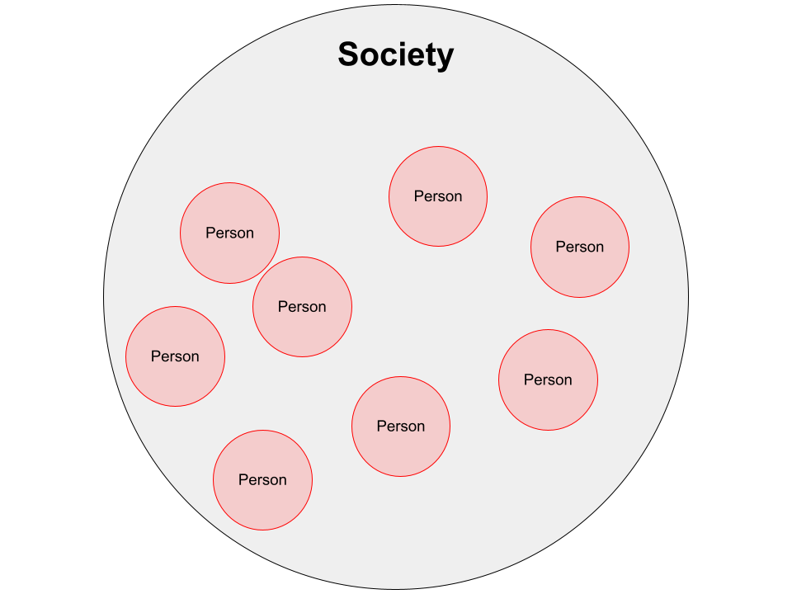
Conceptualising Individual-Society Relationship
Atomised or Liberal Conception:
Alex May – Interconnected Law
10/12/21

Slide 9
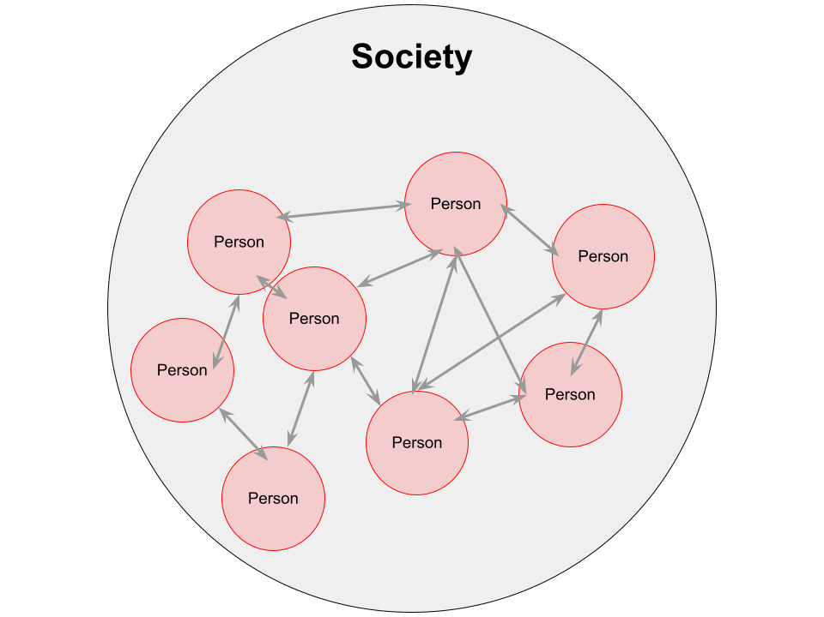
Conceptualising Individual-Society Relationship
Holistic or Relational Conception:
Alex May – Interconnected Law
10/12/21

Slide 10
Social Ecology
1) Our ecological relationships and our social relationships cannot be separated.
We must think in terms of a web of socio-ecological relationships.

Slide 11
Social Ecology
2) The ecological crisis is a social crisis.
Ecological destruction is part of social domination between humans.
Therefore, we must address ecological and social relationships/systems.

Slide 12
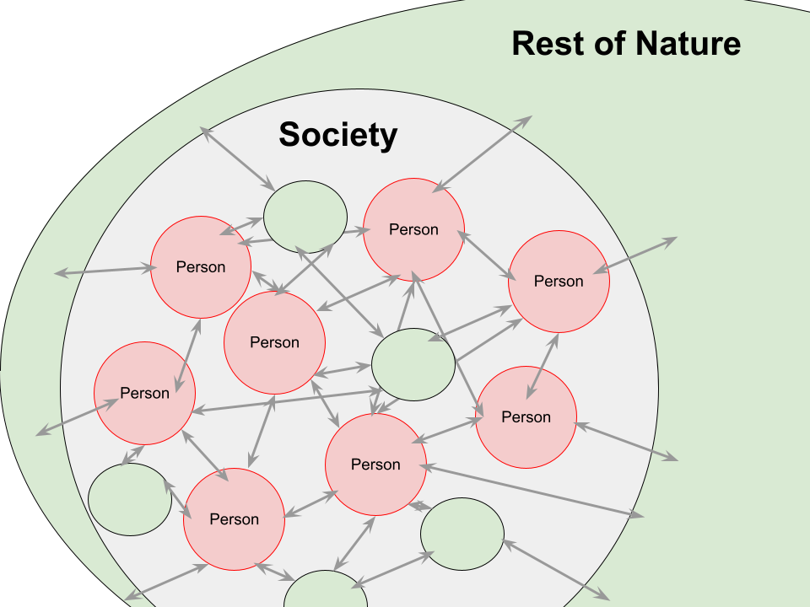
Conceptualising Nature and Society
Alex May – Interconnected Law
10/12/21

Slide 13
Expanding from Earth Jurisprudence
Once we understand society and Nature as a web of socio-ecological relationships, we need an understanding of law which matches this.

Slide 14
Relational Approach (Nedelsky)
Interconnected Law
Earth Jurisprudence
Systems View (Capra and Luisi)
Social Ecology (Bookchin)
Alex May – Interconnected Law
10/12/21

Slide 15
Interconnected Law in Summary
Humans are interconnected: individuals in a dense network of socio-ecological relationships.
Law should be based on this idea of humans, society and nature.
Law is an important part of the web of relationships that exist, it influences, structures, etc, relationships.
Law’s goal should be to improve the web of relations we live in so that they are better – more just, harmonious, empowering – so as to have a better society as part of a Whole Earth Community. Not how do we govern or command but how can we nurture, empower, protect, redirect.
Alex May – Interconnected Law
10/12/21

Slide 16
Conclusion
Earth Jurisprudence to Interconnected Law
This presentation and an expanded article is on my website: www.interconnectedlaw.com/Geneva2021
You can contact me alex@alexmay.co.uk.

